Slide 1
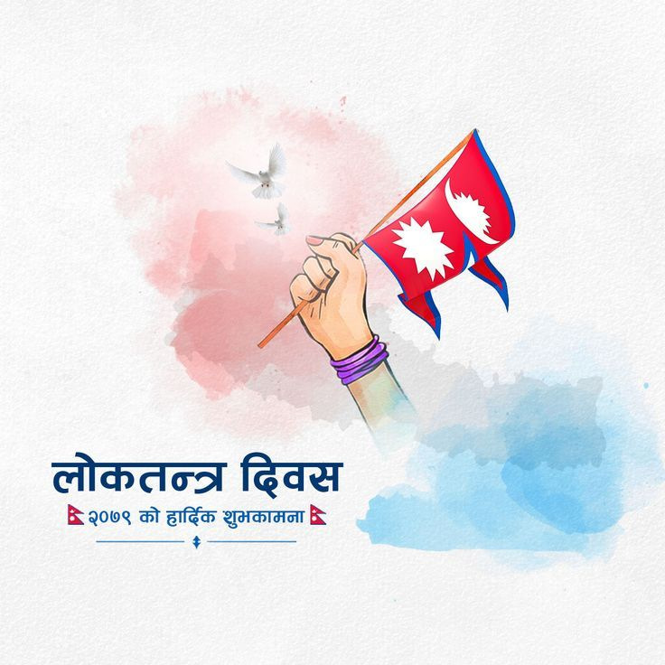
Human Right in Nepal on Democracy

Slide 2
Introduction
Overview of Nepal's transition to democracy.
Mention of the Comprehensive Peace Agreement of 2006.
Establishment of Nepal as a federal democratic republic in 2008.
Historical Context
Pre-democracy era under autocratic rule.
People's movement for democracy in the late 1980s and early 1990s.
Changes leading to the establishment of a constitutional monarchy in 1990.

Slide 3
Constitutional Recognition of Human Rights
Adoption of a new constitution in 2015.
Explicit recognition and protection of a wide range of fundamental human rights.
Inclusion of economic, social, and cultural rights.
Commitment to shaping a just and inclusive society.

Slide 4
Freedom of Expression in a Democratic Context
Legal protections for individual and collective freedom of speech.
Role of media in upholding press freedom and journalistic independence.
Challenges faced by journalists, including censorship and threats.
Importance of a diverse information landscape in a democratic society.

Slide 5
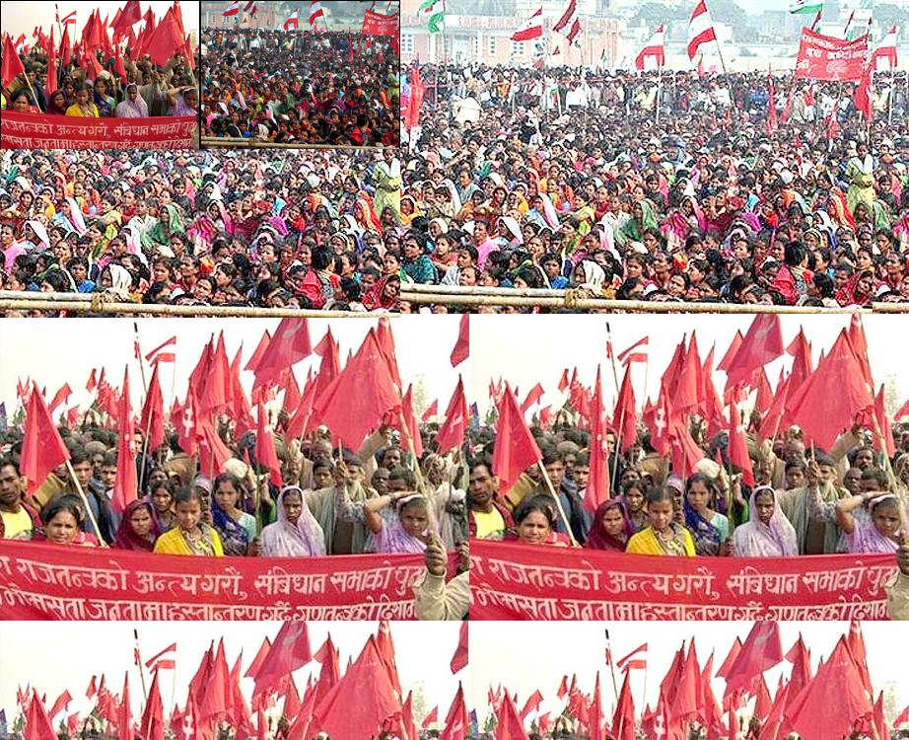
Right to Assembly and Association
Fundamental component of democratic societies.
Empowerment of citizens to gather peacefully and express views.
Role in fostering a vibrant civil society.
Importance of associations in shaping public discourse and policy decisions.

Slide 6

Gender Equality as a Foundational Principle
Constitutional emphasis on fair treatment regardless of gender.
Commitment to equal opportunities for men and women.
Efforts to bridge gender gaps in education, employment, and leadership.
Promotion of women's empowerment and initiatives against stereotypes.

Slide 7
Protection of Minority Rights
Constitutional provisions safeguarding minority interests.
Recognition and protection of distinct identities.
Inclusivity promotion and discouragement of discrimination.
Mechanisms for effective representation in political and public spheres.

Slide 8
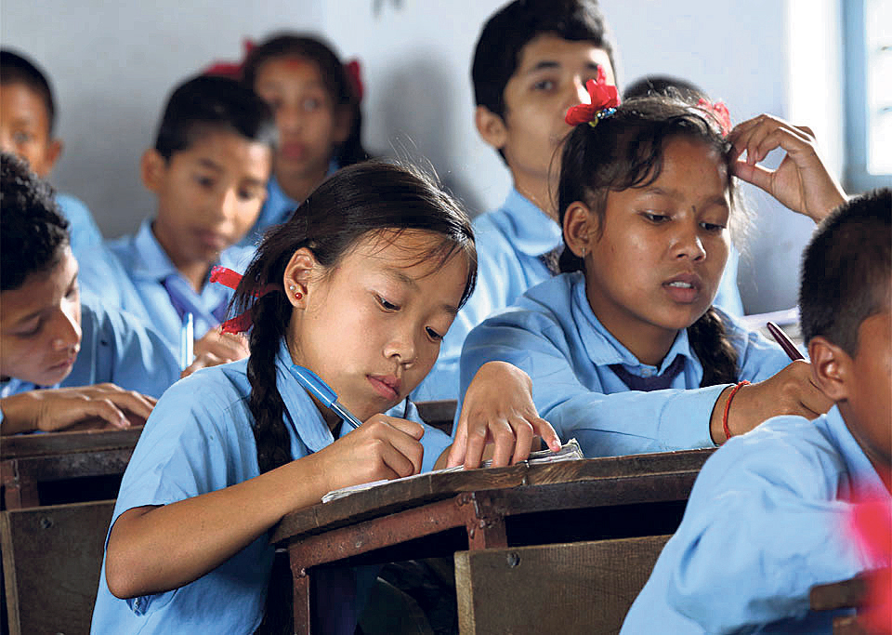
Right to Education for All Citizens
Recognition of education as a fundamental right in the constitution.
Initiatives to enhance access to education, especially for marginalized communities.
Allocation of resources for building schools, hiring qualified teachers, and infrastructure.
Elimination of barriers such as gender discrimination and socio-economic disparities.

Slide 9
Ongoing Legal Reforms in Human Rights
Dynamic process of amendments to fortify human rights protections.
Responsive legal system to address contemporary challenges.
Commitment to aligning national laws with international human rights standards.

Slide 10
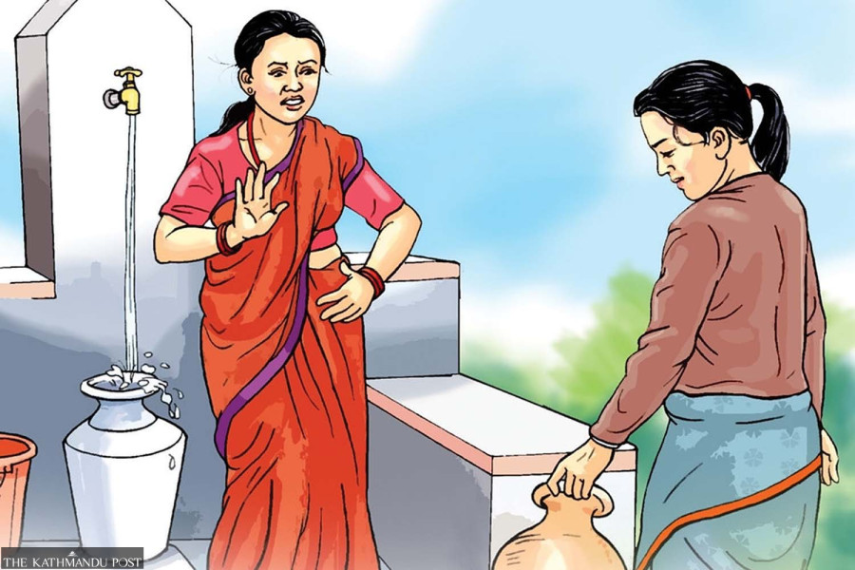
Anti-Discrimination Measures
Crucial components for a just and inclusive society.
Legal frameworks to counter discrimination based on caste, ethnicity, religion, and gender.
Awareness campaigns to change perceptions and foster empathy.
Creation of a foundation for a fairer society valuing individuals for their merits.

Slide 11
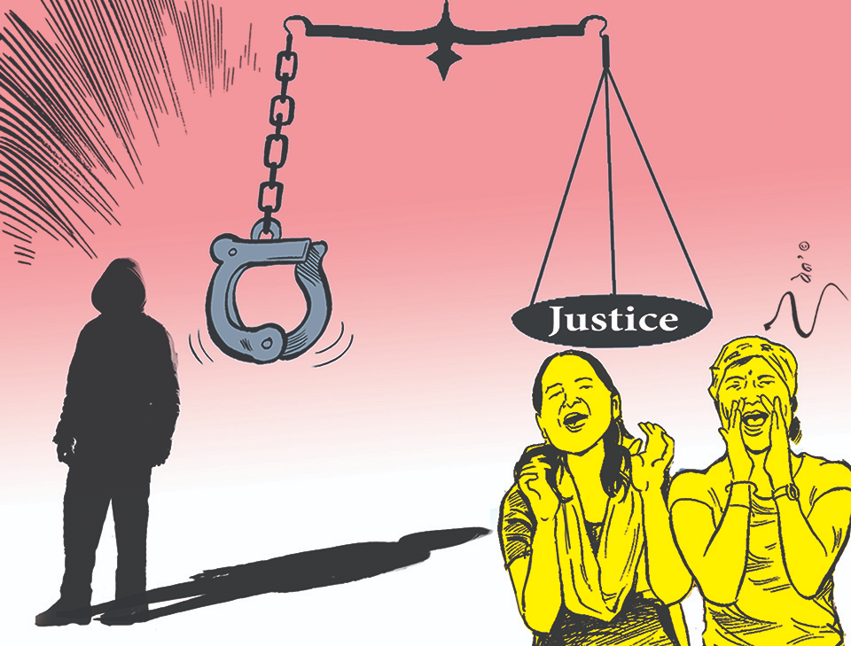
Accountability and Justice Mechanisms
Fundamental principles in addressing human rights violations.
Role of legal frameworks, international tribunals, and domestic courts.
Transitional justice processes for addressing historical grievances and fostering reconciliation.

Slide 12
Implementation Gaps and Enforcement Issues
Existence of challenges in executing well-intentioned policies.
Bureaucratic hurdles, inadequate resources, and lack of commitment.
Discord between intention and action leading to a lack of tangible results.

Slide 13
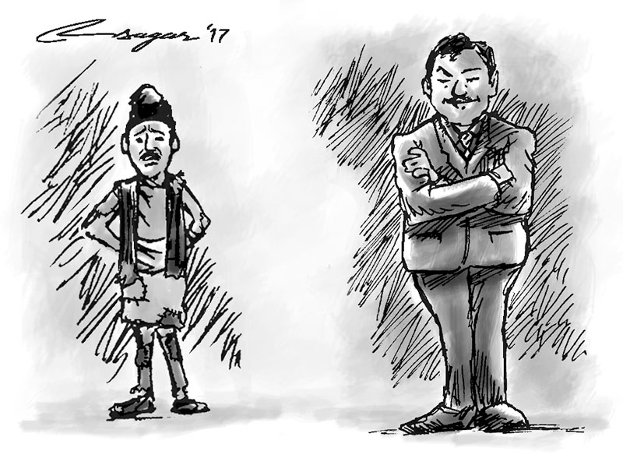
Economic and Social Disparities
Formidable obstacles to comprehensive development.
Inequitable distribution of resources and opportunities.
Impact on marginalized and vulnerable populations.
Perpetuation of cycles of poverty and limited social mobility.

Slide 14
Holistic Approach to Comprehensive Development
Need for a holistic approach beyond policy formulation.
Emphasis on effective implementation and enforcement mechanisms.
Concerted efforts to bridge economic and social gaps.
Promotion of truly inclusive progress reaching all segments of society

Slide 15
Challenges and Hope for Collective Advancement
Persistent challenges in various domains.
Multifaceted nature of issues hindering comprehensive development.
Importance of overcoming implementation gaps and economic disparities.
Call for comprehensive strategies to achieve inclusive and sustainable progress.

Slide 16
Conclusion
In conclusion, Nepal's democratic framework, as reflected in its constitution, underscores a commitment to protecting and promoting fundamental human rights across diverse domains. From freedom of expression to gender equality, minority rights, education, ongoing legal reforms, anti-discrimination measures, and accountability mechanisms, the nation strives for a just and inclusive society. Despite commendable progress, challenges persist, necessitating a holistic approach to address implementation gaps, economic disparities, and foster comprehensive development. By embracing such comprehensive strategies, Nepal can build a society where every citizen enjoys the full spectrum of rights and opportunities, contributing to a more equitable and sustainable future.

